Slide 1
Car Accidents Data Analysis
Muneeb Ullah

Slide 2
Introduction to Storing Accident Data in an SQL Relational Database
Storing accident data in an SQL relational database raises several technical, ethical, and legal considerations

Slide 3
Technical Issues
Data Volume and Scalability: Managing large volumes of accident data requires efficient data storage and retrieval mechanisms to ensure system performance and scalability.
Data Integrity and Consistency: Maintaining data integrity and consistency is crucial to ensure the accuracy and reliability of accident records over time.
Data Security: Protecting sensitive information such as personal details and accident locations from unauthorized access or data breaches is essential to safeguard privacy and comply with data protection regulations.

Slide 4
Ethical Concerns
Privacy and Confidentiality: Collecting and storing personal information about individuals involved in accidents raises concerns about privacy and confidentiality. It's essential to implement robust privacy measures to protect individuals' rights and prevent unauthorized access to sensitive data.
Bias and Discrimination: Analyzing accident data may uncover patterns or correlations that could inadvertently perpetuate bias or discrimination. Ethical considerations must be taken into account when interpreting and using accident data to ensure fairness and equity.

Slide 5
Legal Implications
Compliance with Data Protection Regulations: Storing accident data involves compliance with data protection regulations such as GDPR (General Data Protection Regulation) or HIPAA (Health Insurance Portability and Accountability Act). Adhering to these regulations is essential to avoid legal penalties and protect individuals' rights.
Liability and Accountability: Government agencies storing accident data may be held accountable for ensuring the accuracy, security, and lawful use of the data. Implementing appropriate data governance practices and accountability mechanisms is critical to mitigate legal risks.

Slide 6
SQL Relational Database Solutions
An SQL relational database can address these issues by providing Data Integrity Constraints, Access Control and Authorization, Encryption and Data Masking, Audit Trails and Logging and Disaster Recovery and Backup

Slide 7
Data Integrity Constraints
Technical: Data integrity constraints, such as primary keys, foreign keys, unique constraints, and check constraints, ensure the accuracy and consistency of data stored in the database.
Ethical: Ensuring data integrity helps maintain the trustworthiness of the database and the integrity of accident records. It promotes transparency and accountability in data management.
Legal: Compliance with data protection regulations often requires maintaining accurate and up-to-date records. Data integrity constraints help meet these regulatory requirements by ensuring the reliability and validity of accident data stored in the database.

Slide 8
Access Control and Authorization
Technical: By implementing role-based access control (access, view, modify, or delete), the database can restrict access to sensitive information and prevent unauthorized actions.
Ethical: Protecting the privacy and confidentiality of individuals' personal information is a fundamental ethical principle. Access control measures help uphold these principles by limiting access to only authorized.
Legal: Data protection regulations mandate controlling access to sensitive data to prevent unauthorized disclosure or misuse. Access control mechanisms demonstrate compliance with these regulations by ensuring that only authorized users can access or manipulate.

Slide 9
Encryption and Data Masking
Technical: Encryption techniques, such as encryption at rest and encryption in transit, protect data from unauthorized access. Data masking techniques anonymize sensitive information by replacing real data with fictitious or obfuscated values, preserving data privacy.
Ethical: Encryption and data masking techniques help fulfill the ethical obligations by preventing unauthorized parties from accessing or identifying individuals' personal information in accident records.
Legal: Data protection regulations often require implementing appropriate security measures, including encryption and data masking, to safeguard personal data from unauthorized access or disclosure.

Slide 10
Audit Trails and Logging
Technical: Audit trails and logging mechanisms record details of data access, modifications, and system activities, providing a comprehensive audit trail for accountability and forensic analysis.
Ethical: Transparency and accountability are ethical principles that underpin responsible data management practices. Audit trails and logging mechanisms promote transparency.
Legal: Regulatory compliance often requires maintaining audit trails and logs to demonstrate adherence to data protection regulations and industry standards. Audit trails help meet legal requirements by providing evidence of compliance.

Slide 11
Disaster Recovery and Backup
Technical: By regularly backing up data and implementing disaster recovery plans, the database can minimize downtime, mitigate data loss, and maintain business continuity.
Ethical: Disaster recovery and backup measures help protect stakeholders' interests by preventing data loss or unavailability that could hinder accident investigations or emergency response efforts.
Legal: Compliance with data availability and integrity, including backup and disaster helps mitigate legal risks associated with data loss or service disruptions, ensuring continuity of operations and regulatory compliance.

Slide 12
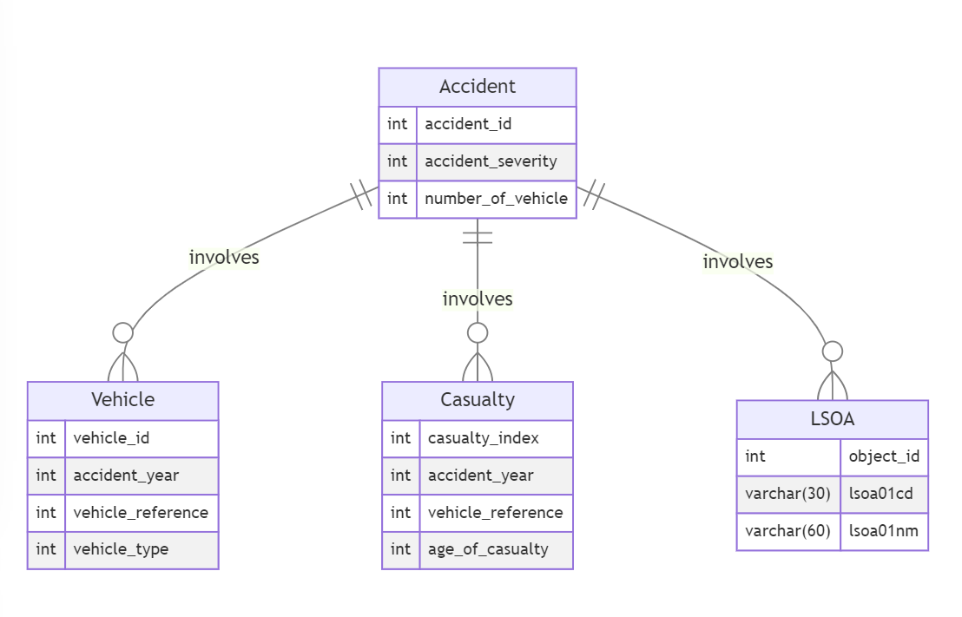
ER Diagram for the Car Accidents Database

Slide 13
Sql commands
Using the full data set from all years

Slide 14
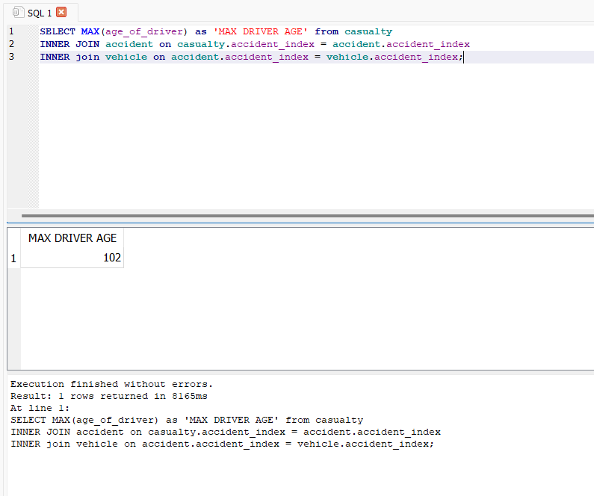
The age of the oldest driver in the casualty table

Slide 15

Total number of vehicles with vehicle type 19

Slide 16

INNER JOIN LSOA

Slide 17

Reading sql in python

Slide 18
THE END

